Slide 1
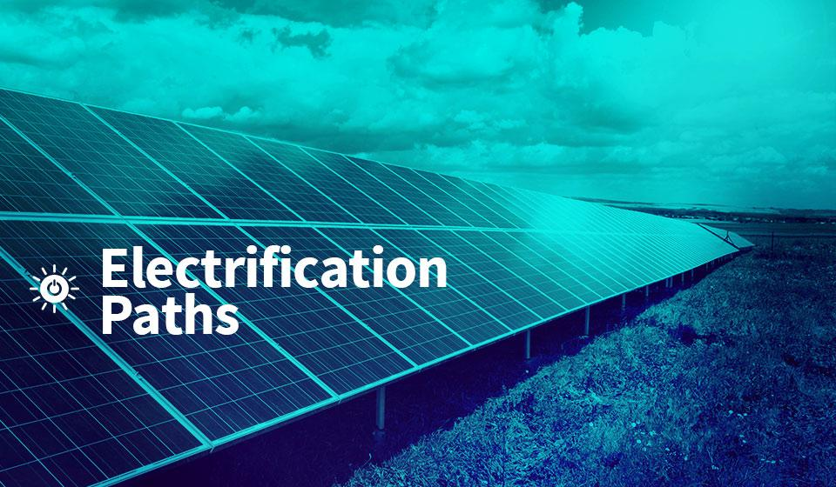
UNIVERSAL ACCESS TO ELECTRICITY

Slide 2
Outline
Chapter 1. Introduction to electrification
Chapter 2. Energy resources assessment using GIS
Chapter 3. Electrification analysis using GIS
Chapter 4. ONSSET – An Open-Source Spatial Electrification Tool
Chapter 5. The online electrification interface
Chapter 6. Hands-on experience with ONSSET
Notes:
We will start with a brief introduction to the universal access to energy challenge and how we can deal with it using GIS energy planning tools. Then we will show how we are using GIS to assess the availability of energy resources and how to carry out electrification planning. Later on, we will introduce ONSSET, the Open-Source Spatial Electrification Tool.
Right after, the online electrification interface based on ONSSET will be presented. The session will close with a hands-on exercise.

Slide 3
3. Electrification analysis using GIS
Specific objective: summarize the steps to analyse the electrification status of countries and regions using GIS
Notes:
The mapping of energy resources is essential in energy planning. Other GIS datasets are also necessary to carry out an electrification analysis and identify the optimal way to provide electricity to populations that lack access.

Slide 4
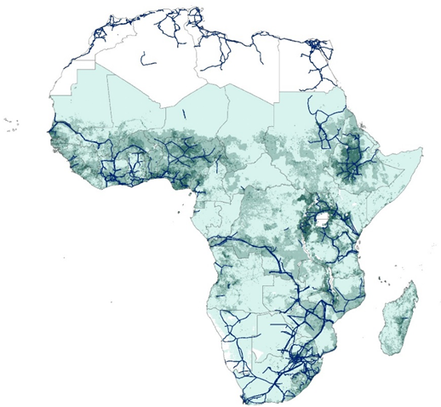
I . Current electrification status (2015)
Current population and transmission network
Geographically identify populations without electricity by combining and analysing various geospatial datasets:
Administrative boundaries
Nighttime light
Transmission network
Power plants
Road network
Population distribution
Areas with high population density, developed grid infrastructure and visible nighttime lights
Currently electrified
Notes:
In the first step of the analysis, we are using a number of datasets to retrieve information about the existing infrastructure as well as identify where populations live. This will give us an indication of where people without electricity are located and where the electricity demand might be. These datasets include administrative boundaries, existing and planned transmission network, existing and planned power plants, road network, population density and distribution, and nighttime lights (helping us identify unserved areas).

Slide 5
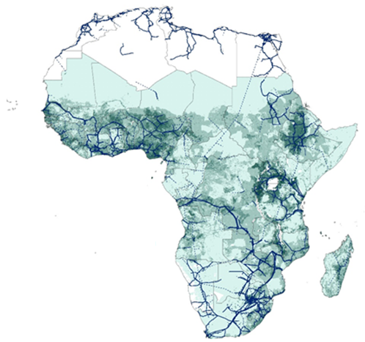
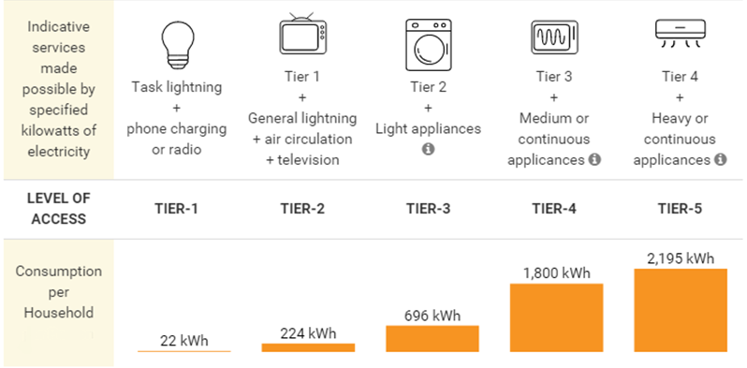
II. Identify future electricity demand
(2030)
Projected population and transmission network
Tiers of electricity access
Electricity demand = population electrification tier
Notes:
Once populations with and without electricity have been spatially identified, we need to incorporate the expected population growth rates per region in order to estimate the total population in 2030 (presented in the map). This is one of the two parameters we need to know in order to quantify and locate future electricity demand. The second parameter is electricity consumption, which is defined by electricity access tiers proposed by the World Bank. These tiers indicate electricity consumption levels, starting from 22 kWh/hh/year (Tier 1 providing electricity to light up a few bulbs, charge a phone or power a radio) up to approx. 2,200 kWh/hh/year (Tier 5 providing electricity to a number of heavy or continuous appliances like a refrigerator, washing machine, oven, etc.). The combination of population growth and electrification tier allows us to calculate future electricity demand per location.

Slide 6
III. Electrification options
Notes:
Covering future electricity demand requires investments in new generating capacity. Two options can be considered. On the one hand, new capacity can be added to the national electricity grid, which will then electrify unserved areas through an extended transmission and distribution network.
On the other hand, new off-grid capacity can be added, operating either through mini-grids or standalone systems covering the demand in each settlement/location based on locally available energy resources. A more elaborative description of the electrification options in presented in the following slides.

Slide 7
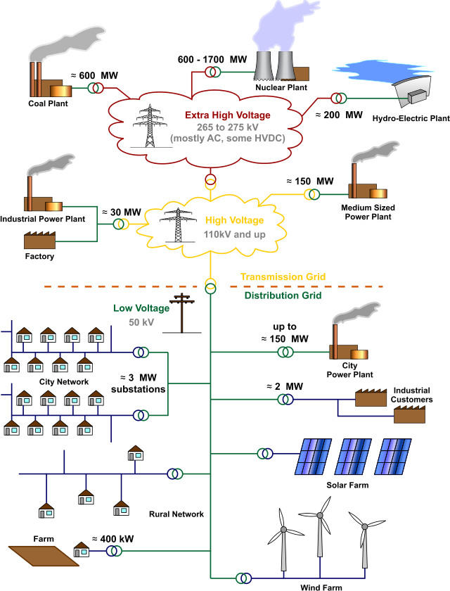
III. Electrification options (a)
Grid extension
Centralized electricity generation
Transmission of electricity with high voltage and mid-voltage lines
Distribution of electricity with mid- and low-voltage lines
Notes:
In principle, grid electricity is generated in a centralized manner, usually from large power plants, which due to economies of scale are able to offer low generating costs from 0.03 to 0.15 $/kWh generated (depending on type and source). Electricity then reaches households through the transmission and distribution network at relatively low costs (if the network is well developed).
The expansion of the electricity grid infrastructure in a country is a capital-intensive and time-demanding process, however. It requires long-term planning and large investments.
A reasonable investment recovery time horizon requires a population with high purchasing power and sophisticated consumption patterns.
It might not be economically feasible to extend the central grid if the population will only demand and be able to afford a relatively small quantity of electricity. Grid extension might not be the optimal electrification option for low-income, low-consumption populations in rural areas, and particularly in remote areas of developing countries.

Slide 8
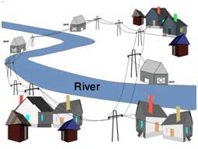
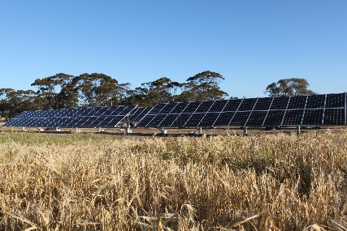
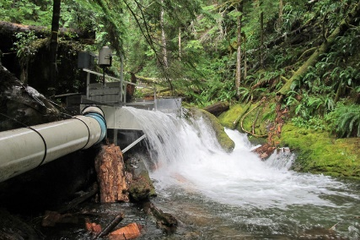
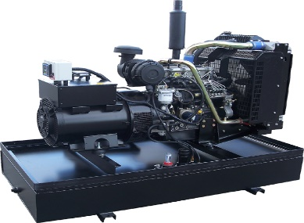
III. Electrification options (b)
Mini-grids
Utilization of locally available energy resources or diesel-fueled gensets
No transmission costs – modest distribution costs
Renewable energy sources involve battery storage
Distribution of electricity with mid- and low-voltage lines
Example of rural electrification with small hydropower
or
or
or
Photovoltaic
Small/mini- hydro
Wind turbine
Diesel generator
Notes:
Mini-grids are an important alternative to grid extension. In this case, electricity is generated in a decentralized manner, usually from power plants with a generating capacity of a few MW. Mini-grids are usually deployed based on locally available energy resources such as solar, hydro or wind, or can be based on commonly available fuels like diesel. Requiring no transmission and modest distribution costs, mini-grids can provide affordable electricity to rural and remote areas with low and medium electricity consumption habits. Mini-grids based on renewable sources have usually high upfront costs but no operational (fuel) costs. Diesel gensets (generators) are a mature, low-cost technology, but operational costs depend on diesel price fluctuations.
A remote and isolated community is one that either is a long distance from highly populated settlements or lacks transportation links that are typical in more populated areas.

Slide 9
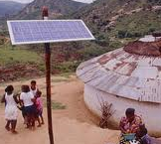
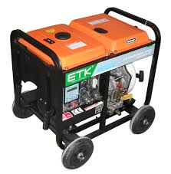
III. Electrification options (c)
Standalone systems
Utilization of locally availably solar energy or diesel gensets
Supplying lower demand levels in single households
No transmission and distribution networks required
PV only may involve battery storage
or
PV
Diesel generator
Notes:
The third option available for electrification involves standalone systems. These systems are usually based on local energy resources in order to produce a few kWh per day, enough to cover the electricity demand of a single household.
Standalone systems do not require a transmission and distribution network. Their capital cost depends only on their size. Batteries may increase the upfront cost for PV systems. Diesel gensets are a mature, low-cost technology, but operational costs depend on diesel price fluctuations.
Standalone systems are a good electrification option for remote, low-population areas with limited electricity consumption needs.

Slide 10
III. Electrification options
Mini-grid options
Solar
Diesel
Wind
Hydro
Standalone options
Notes:
The technologies that have been included in our analysis are the following:
Mini-grid PV
Mini-grid wind
Mini-grid hydro
Mini-grid diesel
Standalone PV
Standalone diesel
In the future, more technologies will be included as well as a combination of the ones mentioned.

Slide 11
Levelized cost of generating electricity
The LCOE from a specific source represents the final cost of electricity required for the overall system to break even over the project lifetime.
I_{t}: investment expenditure for a specific system in year t
O&M_{t}: the operation and maintenance costs
F_{t}: the fuel expenditures
E_{t}: the generated electricity
r: the discount rate
n: the lifetime of the system
$$LCOE= \frac{\sum_{t=1}^{n}{\frac{I_{t}+{O\&M}_{t}+F_{t}}{{\left(1+r\right)}^{t}}}}{\sum_{t=1}^{n}{\frac{E_{t}}{{\left(1+r\right)}^{t}}}}$$
Notes:
How does one compare the options listed in the previous slide?
The selection of the optimal technology for electrification in each location (grid cell) is based on the least-cost option. In other words, the technology offering the lowest levelized cost of electricity generated throughout its lifetime is considered the best electrification solution. The LCOE calculations differ among the considered electrification options.
For the mini-grid and standalone options, the total system costs are considered when calculating the LCOE. On the other hand, the LCOE for the grid expansion is calculated by adding the average COE of the national grid to the marginal LCOE for transmitting and distributing electricity from the national grid to the demand location.

Slide 12
III. Electrification options
Goal: univeral access to electricity by 2030
Seven electrification technologies that fall within three main electrification options and five different demand tiers
Grid → higher electricity consumption levels and close to the planned transmission network
Mini-grid (wind turbines, solar PV, mini/small hydro, diesel gensets) → mini-grids can provide affordable electricity to remote populations with low to medium electricity consumption habits
Standalone (solar PVs, diesel gensets) → for remote, low-population areas with limited electricity consumption needs
Notes:
Before presenting some of the results, let us summarize:
The objective of the electrification analysis is to reach full access to electricity in 44 sub-Saharan African countries.
There are seven electrification technologies considered that fall within three main electrification options or categories. We have also considered five demand tiers.
The technologies are:
Grid → higher electricity consumption levels and close to the planned transmission network
Mini-grid (wind turbines, solar PVs, mini/small hydro, diesel gensets) → mini-grids can provide affordable electricity to remote population with low to medium electricity consumption habits
Standalone (solar PVs, diesel gensets) → for remote, low-population areas with limited electricity consumption needs

Slide 13
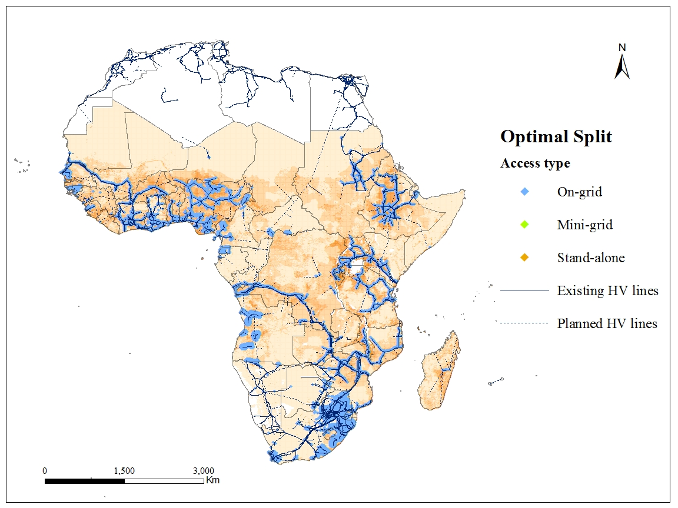
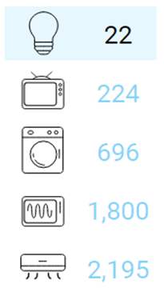
Electrification results – Tier 1 (lighting)
Electricity access
kWh/HH/year
Technology split
Grid extension: | 16%
Mini-grid: | 0%
PV
Diesel
Wind
Hydro
Standalone: | 84%
PV | 50%
Diesel | 50%
Notes:
This map visualizes the selection of the optimal technologies for full electrification of sub-Saharan Africa by 2030. The electricity consumption level is defined by Tier 1 (22 kWh/hh/year) while the diesel price was set at $0.82 per liter following the projections suggested by the New Policy Scenario (International Energy Agency) for 2030. As shown, 16 per cent of electrification is accomplished by grid-based electricity for settlements located close to previously electrified villages and transmission lines, and 84 per cent by standalone systems elsewhere. Mini-grids play a minor role.

Slide 14
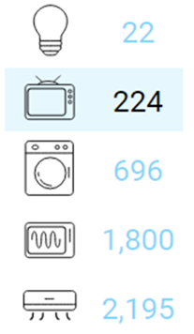
Electrification results – Tier 2 (lighting, fan, TV)
Electricity access
kWh/HH/year
Technology split
Grid extension: | 33%
Mini-grid: | 1%
PV | 0%
Diesel | 4%
Wind | 45%
Hydro | 52%
Standalone: | 66%
PV | 54%
Diesel | 46%
Notes:
If the electricity consumption level increases to Tier 2 (224 kWh/hh/year) the situation differs slightly. In this case, standalone systems are still the predominant electrification solution with PV systems gaining a slightly higher share over diesel gensets. Grid-based electricity is increased from 16 per cent to 33 per cent, but is still a least-cost option for settlements located close to previously electrified villages and transmission lines. Mini-grids play a minor role only, with small hydro and wind power plants having the biggest share.

Slide 15
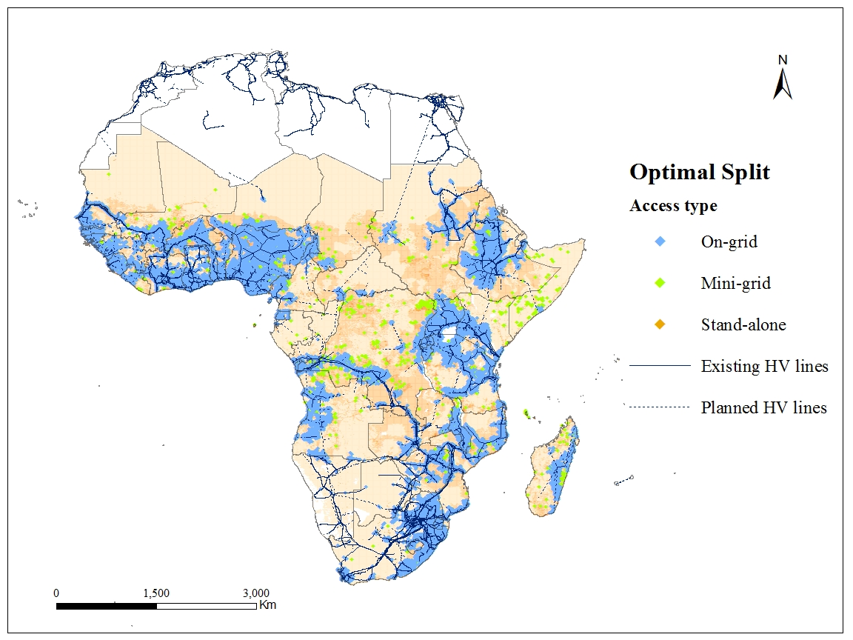
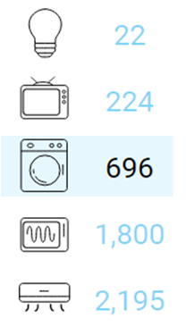
Electrification results – Tier 3 (light appliances)
Electricity access
kWh/HH/year
Technology split
Grid extension: | 67%
Mini-grid: | 3%
PV | 43%
Diesel | 16%
Wind | 17%
Hydro | 25%
Standalone: | 30%
PV | 62%
Diesel | 38%
Notes:
If the electricity consumption level increases to Tier 3 (696 kWh/hh/year), grid extension becomes the most economical electrification option for 67 per cent of newly electrified areas. Standalone systems still play an important role, especially in sparsely populated remote areas. As the electricity consumption increases, however, mini-grid solutions start becoming favourable in remote areas as well. This is even more obvious in the following slide.

Slide 16
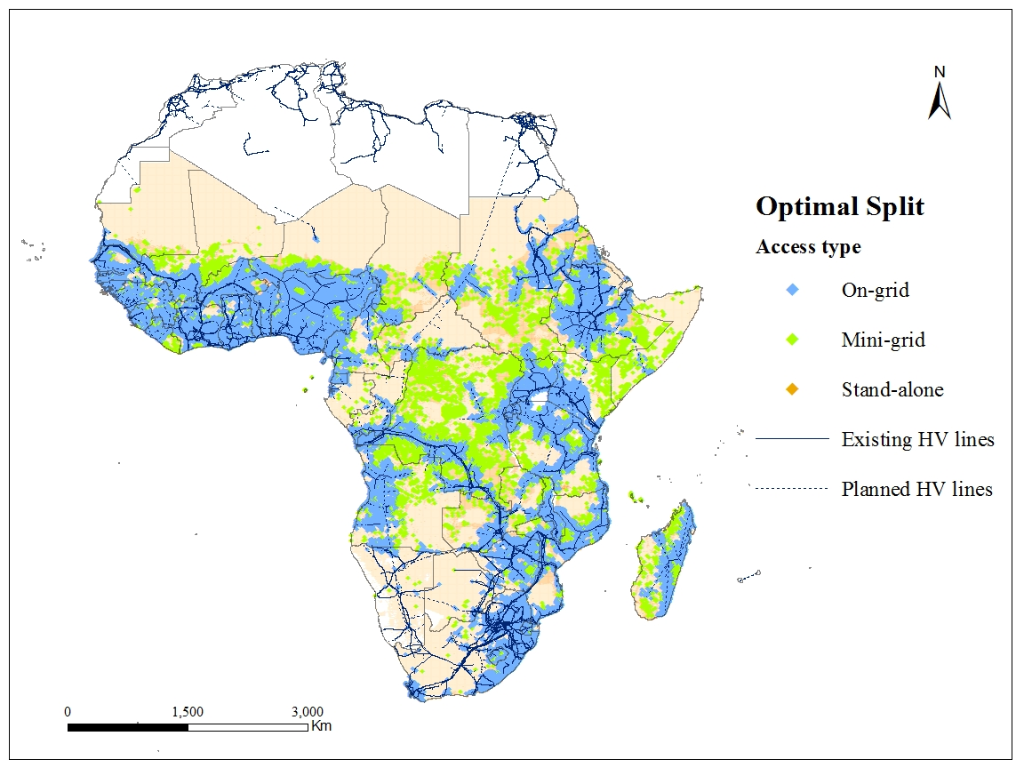
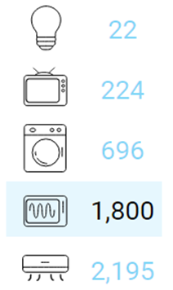
Electrification results – Tier 4 (medium appliances)
Electricity access
kWh/HH/year
Technology split
Grid extension: | 77%
Mini-grid: | 8%
PV | 50%
Diesel | 26%
Wind | 11%
Hydro | 14%
Standalone: | 15%
PV | 66%
Diesel | 34%
Notes:
Here the electricity consumption level is 1,800 kWh/hh/year (Tier 4). The increased demand favours grid extension, which in this scenario accounts for 78 per cent of newly electrified areas, and mini-grids (predominantly PV systems and diesel gensets).

Slide 17
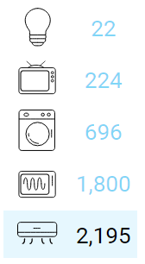
Electrification results – Tier 5 (heavy appliances)
Electricity access
kWh/HH/year
Technology split
Grid extension: | 78%
Mini-grid: | 10%
PV | 52%
Diesel | 27%
Wind | 11%
Hydro | 10%
Standalone: | 12%
PV | 65%
Diesel | 35%
Notes:
Finally, with Tier 5 (2,195 kWh/hh/year), grid extension increases slightly in comparison with the previous scenario, but still accounts for the biggest portion of the newly electrified area. Mini-grid technologies become the least-cost option for 10 per cent of the population to receive electricity, while standalone systems will provide electricity to 12 per cent.

Slide 18
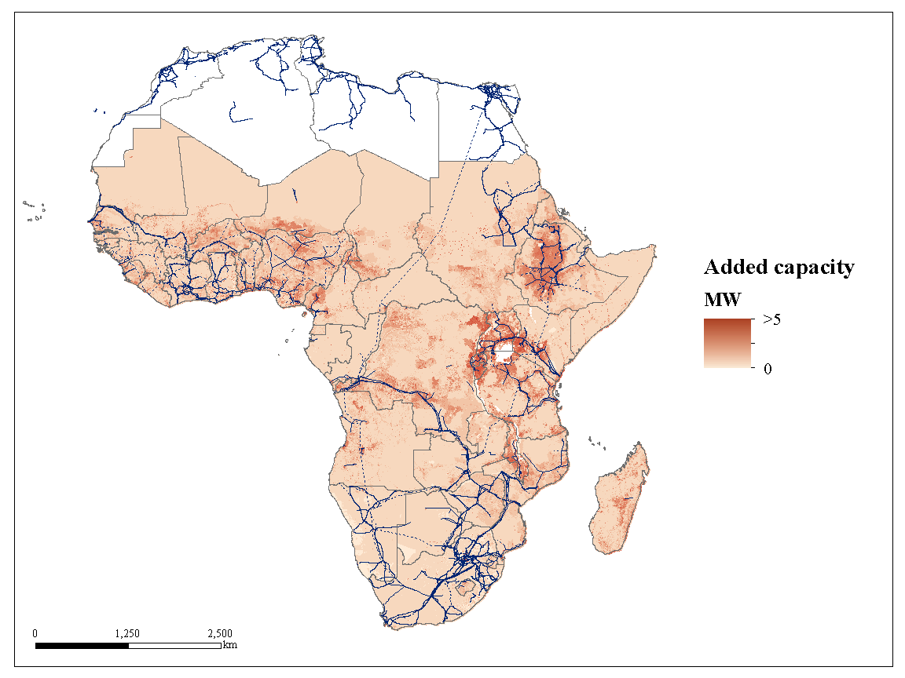
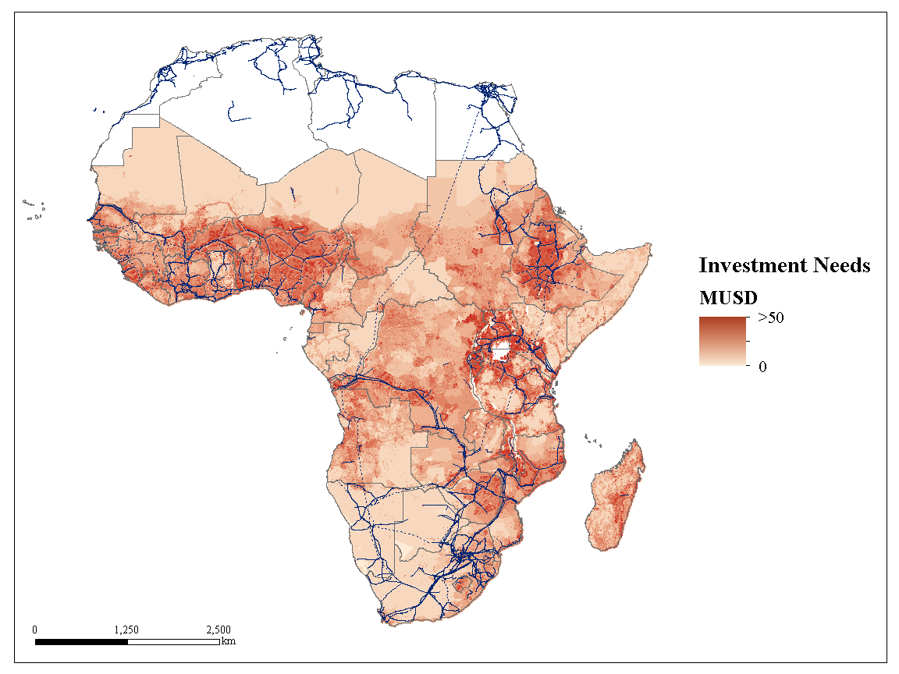
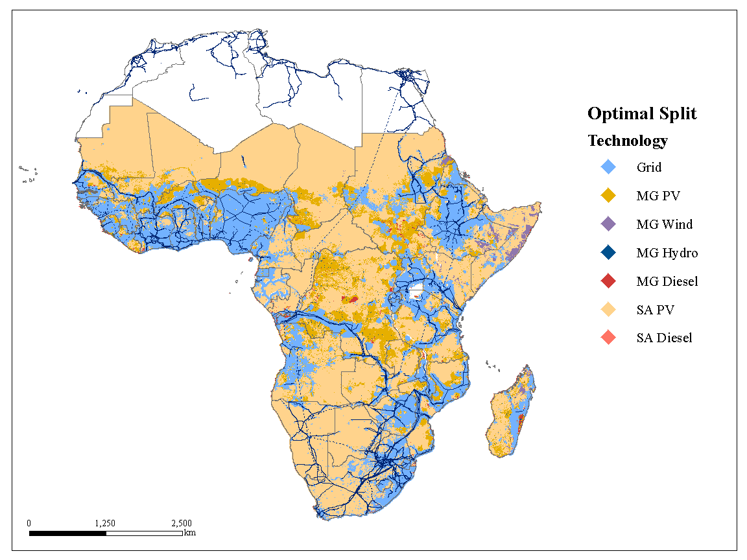
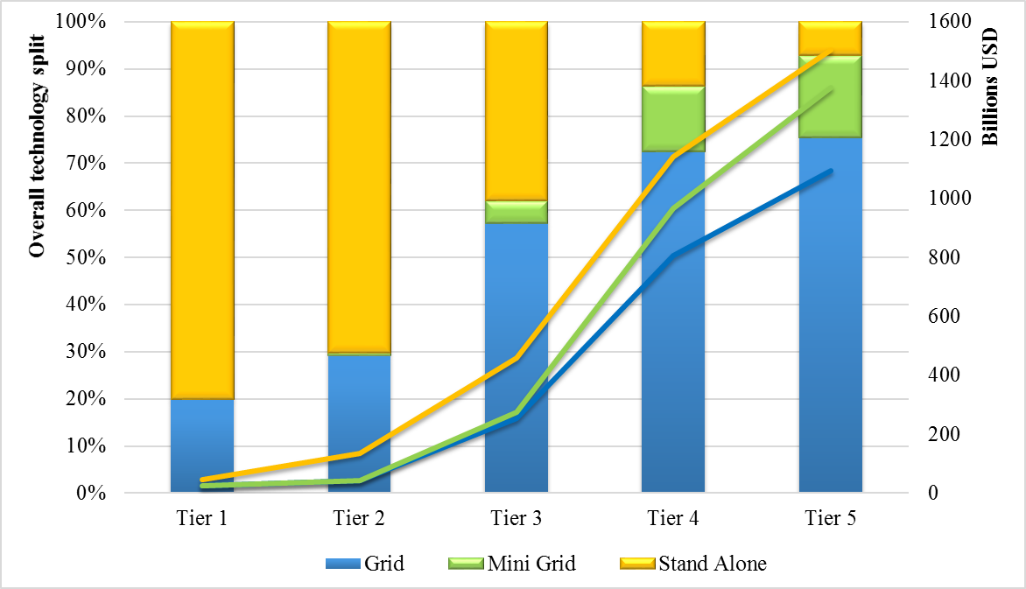
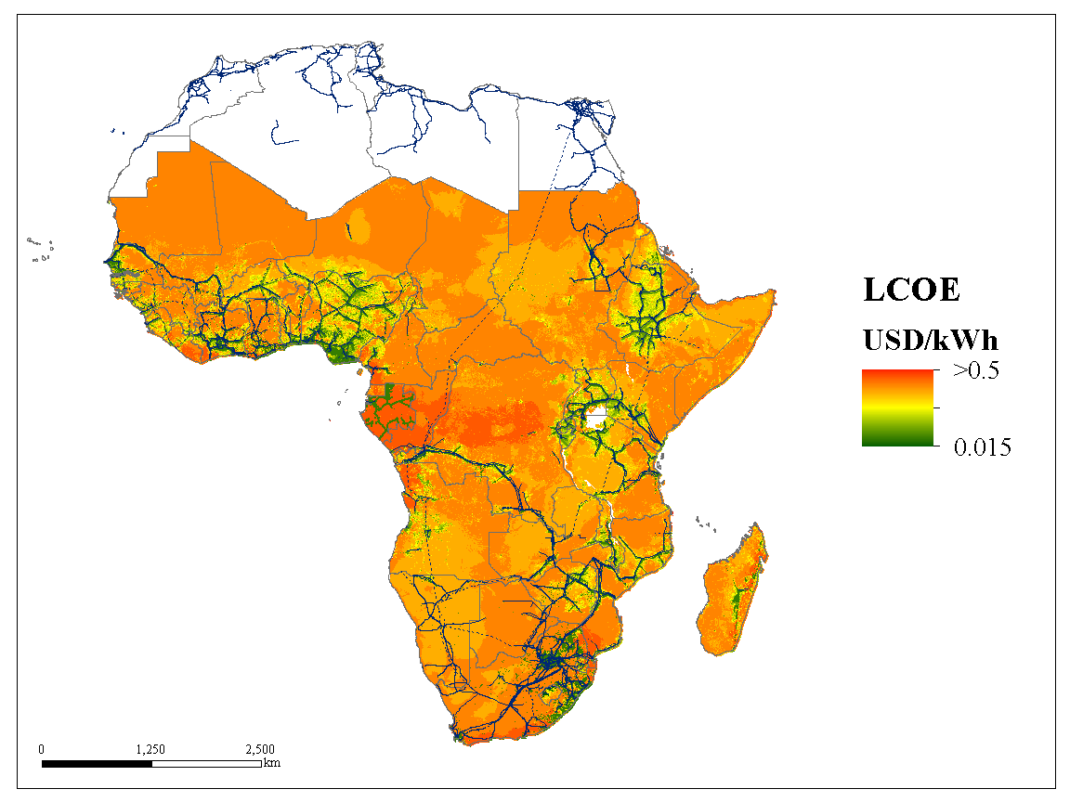
Electrification results summary
Investment needs and access type
Notes:
This graph summarizes the results. The share of access type is seen on the left Y axis, the investment needs on the right Y axis and the different consumption levels on the X axis. Bars show the access type and lines the investment needs. The latter range from $44 billion to roughly $1.5 trillion to reach universal access to electricity. Also, increasing electricity demand (Tier 1 → Tier 5) moves the least-cost option from standalone to mini-grid to grid.

Slide 19
Electrification results – interpretation
Grid extension is favourable in areas with high population density and proximity (<50 km) to the grid network.
The diesel price significantly affects the electrification mix. Lower prices favour diesel gensets while higher prices favour mainly PV systems.
Hydro and wind-based mini-grid solutions usually appear in areas where these resources are available and are little affected by diesel prices.
Increased electricity demand (Tier 1 → Tier 5) moves the least-cost option from standalone → mini-grid → grid.
The renewable energy share in total electricity generation in sub-Saharan Africa increases from 34 per cent in 2012 to ~66 per cent in 2030.
Notes:
Let’s summarize the results presented in the previous slides.
To start with, grid extension is the least-cost solution in densely populated areas close to the grid network.
Diesel prices influence the electrification mix. Lower prices favour diesel gensets, while higher prices imply higher penetration of mainly PV systems.
Other renewables (wind, hydro) penetrate in areas where these resources are available and signify decent potential.
Higher electricity demand levels move the favourable electrification option from standalone to mini-grid to grid.
The share of renewable energy sources in total electricity generation almost doubles from 34 per cent in 2012 to around 66 per cent in 2030.

Slide 20
Electrification results – limitations
Shows only end state: the analysis ignored the dynamic expansion over time.
The country-specific grid-based generation mix has not been considered in detail in this analysis.
Hybrid technologies (such as wind + diesel configurations, etc.) are not yet considered.
Various resolutions: The resolution of various datasets differs (e.g., population density data are given at 1 kilometre while the wind speed at ca 50 kilometres).
Residential electrification: The analysis considers only household electrification. Other productive uses of electricity should also be taken into account.
Homogeneous consumption levels across the studied area.
Notes:
The present analysis has some limitations, which we are addressing while developing the model we will introduce in the next section.
The electrification mix is shown only for the end year, which is 2030. The electrification mix and status in the meantime (between today and 2030) is not considered. To do so, one would have to decide the priority areas that need to be electrified first.
Furthermore, the detailed breakdown of the generation mix of each country, which provides different grid electrification costs, is not taken into account. To do so, we would have to link GIS with OSeMOSYS to obtain the optimal mix based on the country’s resources, demand and trade with other countries.
Another critical issue is the various resolution of different datasets. To illustrate, population density data are given at 1 kilometre while the wind speed at ca 50 kilometres. This means that we need to harmonize our datasets, which sometimes leads to misleading representation of information.
The analysis considers only household electrification. Other productive uses of electricity (such as for health care, education, rural enterprises, agriculture, etc.) should also be taken into account. These would increase the demand levels and therefore the electrification mix.
Lastly, keep in mind that in this analysis, we have assumed five homogeneous consumption levels across Africa, but significant income differences across the continent would imply different electricity demand levels. There are mathematical correlations in the literature that relate nighttime light with income and electricity consumption levels.

Slide 21
Hands-on exercise
Exercises with the geospatial electrification model

